Slide 1
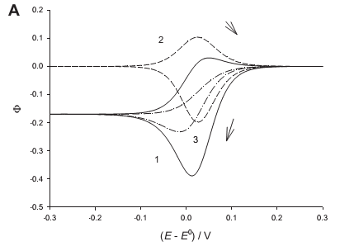
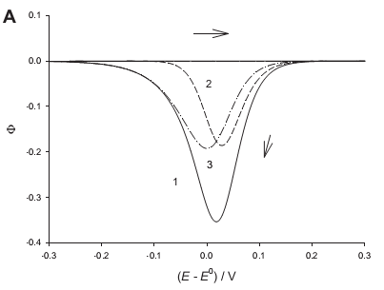
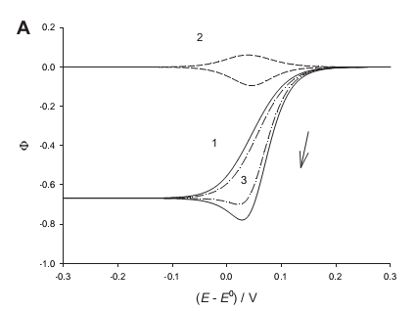
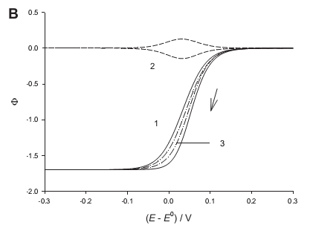
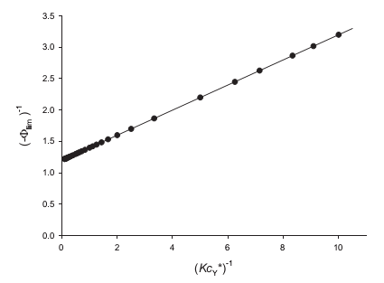
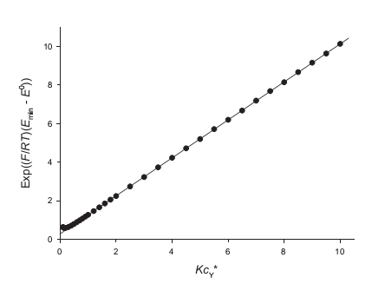
Influence of product adsorption on catalytic reaction determined by Michaelis-Menten kinetics Šebojka Komorsky-Lovrić and Milivoj Lovrić Department of Marine and Environmental Research, “Ruđer Bošković” Institute, Zagreb, Croatia
Introduction
A stationary plate electrode made of pyrolytic graphite can be chemically prepared by the strong and irreversible adsorption of a monolayer of a certain redox couple and used as a catalyst in electrochemical reactions of dissolved substrates. The homogeneous catalytic reaction between the attached couple and the substrate occurs because the electrode reaction of the latter is kinetically hindered. This reaction scheme belongs to the catalytic EC' mechanism that was investigated for chronoamperometry and linear scan, cyclic and square-wave voltammetry. In protein film voltammetry the catalyst can be adsorbed enzyme and the substrate can be either some other protein or various inorganic and organic molecules. These reactions may be governed by the Michaelis-Menten kinetics. As the catalytic step is totally irreversible, the role of final product is usually neglected although it is possible that it stays bound to the electrode surface for a certain period of time. In this poster the partial inactivation of the catalyst by the adsorbed product is investigated theoretically.
The model
A reversible surface electrode reaction coupled to totally irreversible electrochemical reaction of the substrate is considered:
Conclusions
The adsorption and desorption of product of catalytic reaction are important steps of EC' mechanism. They control the surface concentration of the complex between catalyst and substrate and the establishment of steady-state. The rate of dissociation of the product from the surface can be neglected only if it is infinitely high. Generally, the response of electrocatalytic mechanism in cyclic voltammetry exhibits a minimum in the reductive branch, which is followed by the limiting current under steady-state conditions. The later is useful for kinetic measurements. The response acquires the sigmoidal form if there is no influence of the product.
Fig. 1 Dimensionless cyclic voltammogram (1) and its surface (2) and catalytic (3) components. Kc_{Y}* = 1, κ₀ = 1, κ_{dis} = 0.257 and E_{st} = 0.3 V vs. E⁰.
The surface and catalytic reactions are connected by the formation of the surface complex (BY)_{ads}. The product
of catalysis remains adsorbed and dissociates from the electrode surface by the finite rate. Initially, the reactant A
is adsorbed in the concentration Γ_{A}* and no further adsorption or desorption of the redox couple A and B are
assumed. Finally, it is assumed that the substrate Y is present in a great excess, so that its diffusion can be
neglected. For cyclic voltammetry the dimensionless total current Φ = I (FSΓ_{A}*|a|)⁻¹, where |a| = (F/RT)|dE/dt|, is
calculated by the numerical integration as a function of electrode potential. The surface and the catalytic
components of the current are also reported. The responses depend on the dimensionless rate constants κ₀ = k₀/|a|
and κ_{dis} = k_{dis}/|a| and the dimensionless product Kc_{Y}*.
Results and discussion
Figure 1 shows dimensionless cyclic voltammogram of electrochemical reactions (1) – (4). The total current,
marked as 1, is characterized by the minimum Φ_{min} = -0.3890 at E_{min} = 0.0125 V vs. E⁰, the limiting value Φ_{lim} =
-0.1697 and the maximum Φ_{max} = 0.0302 at E_{max} = 0.050 V. The minimum is caused by the minima of both
components and the maximum by the surface component. The minimum of the catalytic component is caused by
the maximum surface concentration of the complex BY that appears at -0.015 V. The limiting current is a
consequence of steady-state that is established at potentials lower than -0.2 V.
LimΦ₂ = -κ₀Kc_{Y}*(1 – Γ_{BP} / Γ_{A}*)(1 + Kc_{Y}*)⁻¹ (5)
The limiting values of the total current and the catalytic component are equal because the surface current tends to
zero at E < -0.2 V. In the reverse branch of cyclic voltammogram the product dissociates from the electrode
surface at potentials at which the catalyst is oxidized and the concentration of the complex BY decreases to zero.
The catalyst may become totally blocked if the product does not dissociate. This can be seen in Figure 2. The
response exhibits the minimum at 0.018 V in the forward branch, but zero current in the reverse branch. This is
because the concentration of the complex BP does not change during the reverse scan.
Under the influence of increased rate constant of dissociation of the complex BP the response becomes sigmoidal
curve. This is shown in Figure 3. If κ_{dis} = 0.77 the minimum response is -0.7785, the peak potential is 0.028 V
and the limiting response is -0.6678. The ratio between minimum and limiting currents is 1.166. With the further
increasing of κ_{dis} the minimum disappear and the limiting current decreases to -1.7. If the dissociation of BP
complex is infinitely fast, the blockade of catalyst can be neglected and the limiting current tends to -5. If dE/dt
= 0.1 V/s the dimensionless rate constants of dissociation used in these calculations correspond to the real
constants k_{dis} = 3 s⁻¹ and 10 s⁻¹, respectively.
The concentration of substrate is a variable that can be changed experimentally. Equation (5) can be rearranged
to the form:
LimΦ₂ = -κ_{dis} z (κ_{dis} + z)⁻¹ (6)
where z = κ₀Kc_{Y}*(1 + Kc_{Y}*)⁻¹. Considering that Φ_{lim} = limΦ₂, equation (6) can be further rearranged:
-Φ_{lim}⁻¹ = κ_{dis}⁻¹ + κ₀⁻¹ + κ₀⁻¹K⁻¹(c_{Y}*)⁻¹ (7)
This equation shows that the inverse value of limiting current is linearly proportional to the inverse value of
concentration of substrate. A theoretical example of this relationship is shown in Figure 4. For the parameters
used in this calculation, the slope and intercept of this straight line are 0.2 and 1.2, respectively. In the real
experiment the slope is (FSΓ_{A}*)⁻¹k₀⁻¹K⁻¹ and the intercept is (FSΓ_{A}*)⁻¹(k_{dis}⁻¹ + k₀⁻¹). The equilibrium constant can
be estimated from the dependence of peak potential on the concentration of substrate. The results of simulation
that are shown in Figure 5 confirm that the function Exp[(F/RT)(E_{min} – E⁰)] depends linearly on the product
Kc_{Y}*, with the slope 0.98 and the intercept 0.3. This means that the relationship between this function and the
substrate concentration is a straight line with the slope 0.98 K. The standard potential of the electrode reaction
(1) can be determined in the absence of substrate.
Fig. 2 Cyclic voltammogram (1) and its surface (2) and catalytic (3) components. Kc_{Y}* = 1,
κ₀ = 1, κ_{dis} = 0 and E_{st} = 0.3 V vs. E⁰.
Fig. 3 Cyclic voltammogram (1) and its surface (2) and catalytic (3) components. Kc_{Y}* = 1, κ₀ = 10, E_{st} = 0.3 V vs. E⁰ and κ_{dis} = 0.77 (A) and 2.57 (B).
Fig. 4 Linear relationship between inverse limiting current and inverse product Kc_{Y}*; κ₀ = 5 and κ_{dis} = 1.
Fig. 5 Dependence of the function of peak potential on the product of equilibrium constant and substrate concentration; κ₀ = 5 and κ_{dis} = 1. The straight line is a linear approximation that applies to Kc_{Y}* > 0.2.
Acknowledgement
The financial support by the Croatian Science Foundation in the frame of the project number IP-11-2013-2072 is gratefully acknowledged.

