Slide 1
Preliminary analysis of the 2017 winter cruise data in the northern Adriatic within the frame of the EcoRENA project

Slide 2
List of authors
Supić Nastjenjka¹, Irena Ciglenečki², Jelena Dautović², Tamara Djakovac¹, Mathieu Dutour-Sikirić², Ingrid Ivančić¹, Ivica Janeković², Romina Kraus¹, Nataša Kužat¹, Davor Lučić³, Daniela Marić Pfannkuchen¹, Jakica Njire³, Paolo Paliaga¹, Miroslava Pasarić⁴, Zoran Pasarić⁴ and Robert Precali¹
¹Center for Marine Research, Rudjer Bošković Institute, Rovinj
²Divison for Marine and Environmental Research, Rudjer Bošković Institute, Zagreb
³University of Dubrovnik, Dubrovnik
⁴ Faculty of Science, University of Zagreb, Zagreb

Slide 3
The winter of 2017 in the northern Adriatic
preliminary analysis of physical, chemical and biological data collected in the winter of 2017
as a first step in developing the ecological model for the northern Adriatic
work has been performed under the frame of EcoRENA project

Slide 4
Project EcoRENA
project funded by the Croatian Ministry of Science: Ecological response of northern Adriatic to climatic changes and anthropogenic impact (EcoRENA)
aim of the project: to understand the northern Adriatic response to climatic changes

Slide 5
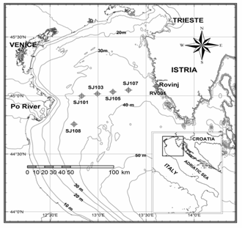
Northern Adriatic (NA)
NA is a shallow (down to 50 m) northernmost part of Adriatic
can be influenced by low salinity and nutrient rich waters from the Po River delta area
Figure: Map of the region with position of standard stations.

Slide 6
Northern Adriatic (NA)
region of dense water formation
dense water flows out of NA and fills the deepest Adriatic and Mediterranean pits
NA dense water impacts the biogeochemical processes in a large area
Figure: Map of the region with position of standard stations.

Slide 7
Types of NA winter conditions
based on earlier research of long term data we found that there are two basic types of NA winter conditions: A and B
main difference between the two types is under the impact of Po River waters: in A winters they spread across the NA inducing large bio-production, in B winters the NA is under impact of oligotrophic high salinity waters from central Adriatic

Slide 8
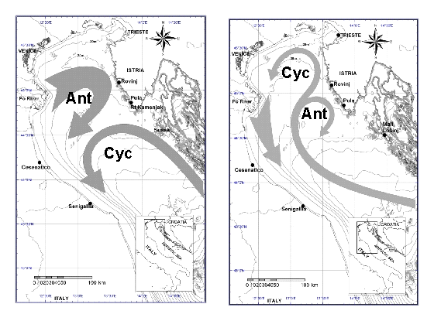
Hypothesized circulation patterns in winters of A and B type:
type A type B

Slide 9
List of winter types in 1981-2015:
year | BD - west | BD -east | TYPE | T | S | Sigma-t
1981 | 29.8 | 29.8 | similar to A | 8.6 | 38.3 | 29.8
1982 | 29.4 | 29.4 | similar to A | 9.2 | 37.6 | 29.2
1987 | 29.8 | 29.5 | B | 8.3 | 38.0 | 29.6
1990 | 29.6 | 29.2 | B | 10.1 | 38.2 | 29.4
1991 | 29.9 | 29.8 | B | 8.3 | 37.9 | 29.5
1993 | 29.0 | 29.2 | A | 8.9 | 37.3 | 28.9
1994 | 29.5 | 29.2 | B | 9.6 | 37.9 | 29.3
1995 | 29.2 | 29.2 | similar to A | / | / | /
1998 | 29.1 | 29.1 | similar to A | 9.9 | 37.1 | 28.6
1999 | 29.8 | 29.6 | B | 8.7 | 38.2 | 29.7
2000 | 29.9 | 29.6 | B | 8.7 | 38.1 | 29.6
2001 | 28.7 | 29.0 | A | 11.6 | 37.8 | 28.8
2003 | 29.7 | 29.6 | B | 8.5 | 38.1 | 29.6
2004 | 29.6 | 29.7 | A | 8.7 | 37.0 | 28.7
2005 | 29.9 | 29.6 | B | / | / | /
2006 | 29.9 | 29.7 | B | 8.2 | 38.3 | 29.8
2007 | 29.0 | 29.1 | A | 11.6 | 38.0 | 29.0
2008 | 29.4 | 29.5 | A | 9.6 | 37.8 | 29.2
2010 | 29.4 | 29.2 | B | 9.3 | 37.8 | 29.3
2015 | 29.0 | 29.0 | similar to A | 10.0 | 36.8 | 28.3
Table: Bottom density (BD) in western and eastern NA (BD-west and BD-east); winter type; temperature, salinity and sigma-t values at transect Po River delta-Rovinj. All values refer to February.

Slide 10
Two winter types and preconditioning
A and B type winters depend on previous autumn condition: very low evaporation in previous November for A; very intense evaporation in previous November for B
The BIOS mechanism possibly has an important role in the appearance of each type!

Slide 11
Winter 2017
the winter of 2017 in the NA region was preceded by an autumn which was warmer and with more rain than on average
therefore we expected that winter 2017 is of A type with low salinity in the NA, probably high nutrients and high bioproduction

Slide 12
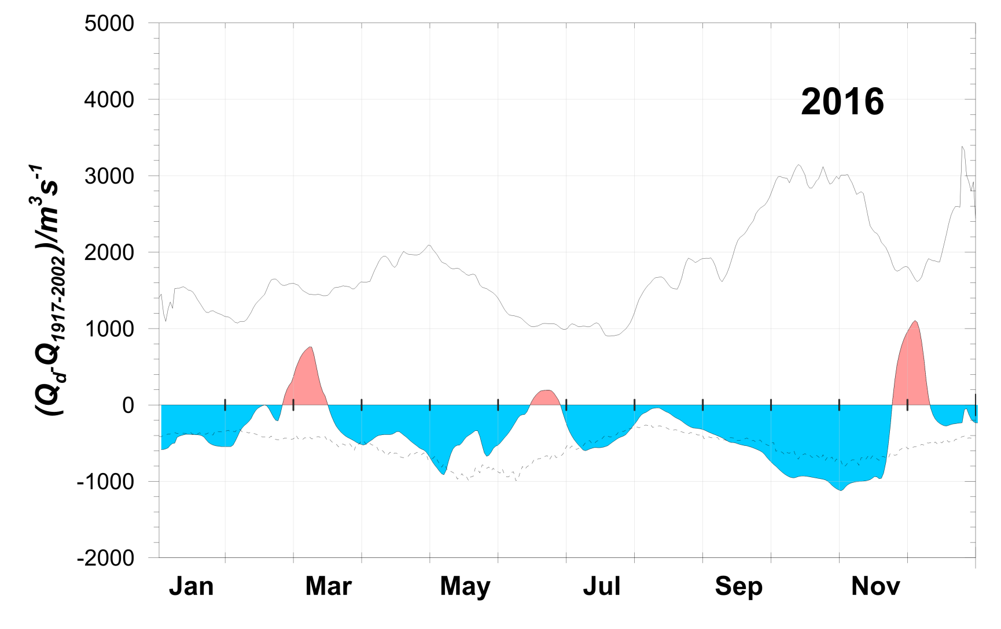
Po discharge rates in 2016 were generally below average
Difference between the daily and long term averaged Po discharge rates with mean positive and negative deviations.

Slide 13
In this presentation we:
1) describe oceanologic conditions in NA during the winter of 2017 to determine the winter type
2) describe characteristics of dense water flowing out of the NA

Slide 14
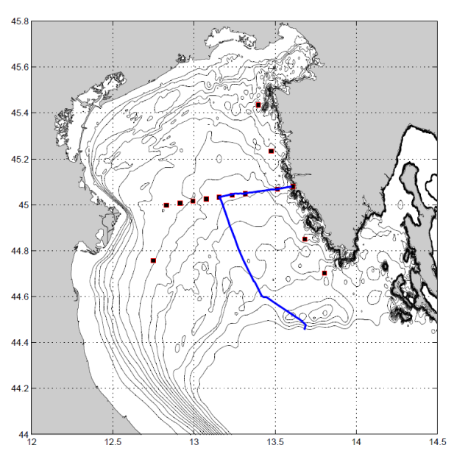
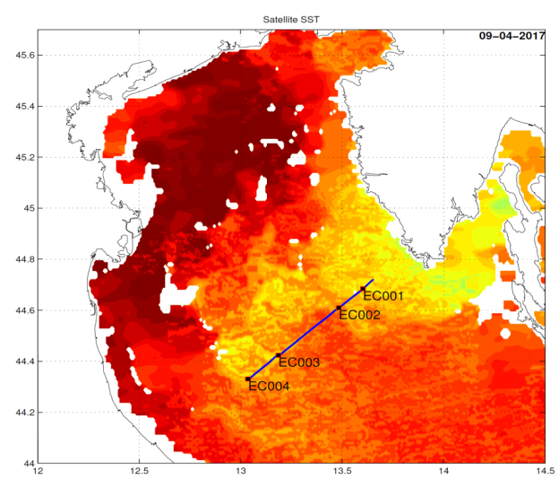
Winter 2017 cruises
27 January at SJ108-RV001;
13 February in eastern NA by an undulating vehicle;
16 February at SJ101-RV001;
28 March at SJ108-RV001;
9 April in open NA by an undulating vehicle and at EC001-EC003

Slide 15
February 2017
We concentrated on February cruise and stations SJ101 (west part of NA) and SJ107 (east part of NA)

Slide 16
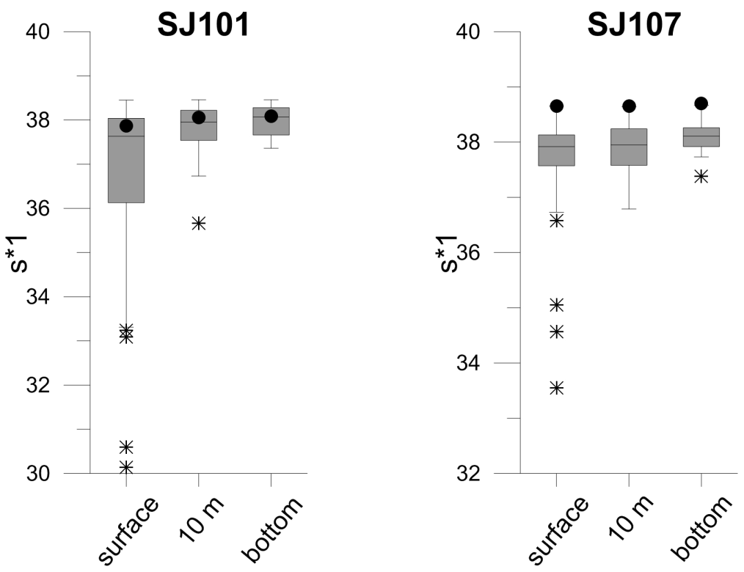
February 2017
Salinity: high, around 38 at SJ101 and 38.6 at SJ107; values at SJ107 among the highest values observed in NA
February salinity values at SJ101 (west) and SJ107 (east) over the period 1969-2016 (Box-Whisker) and 2017 values (black dot).

Slide 17
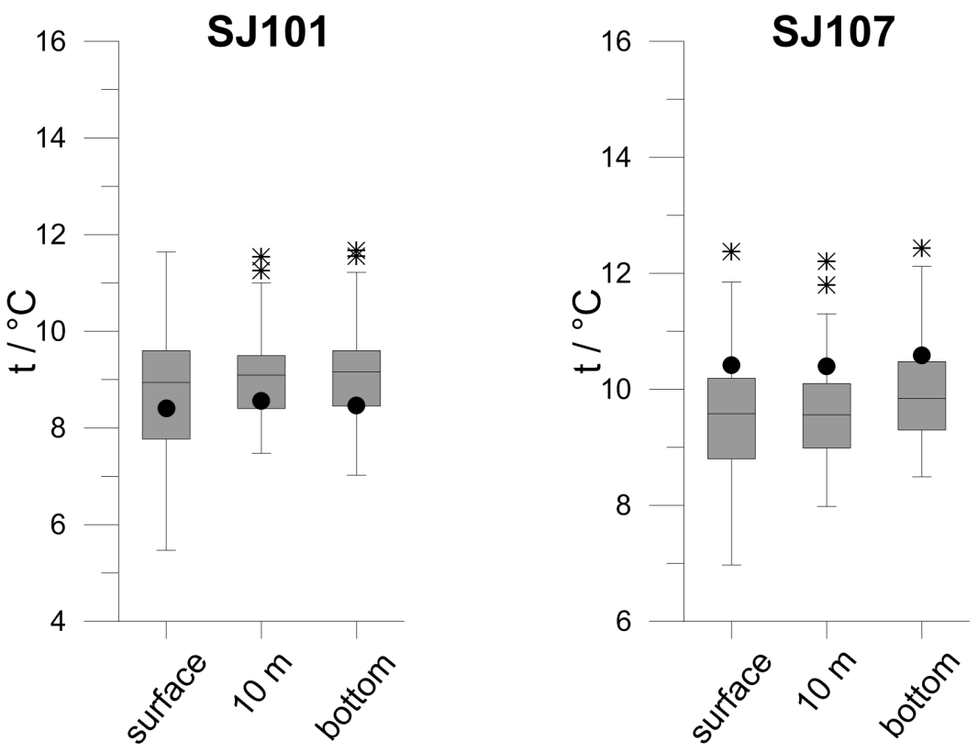
February 2017
Temperature: below the average in the western and above the average in the eastern part
February temperature values at SJ101 (west) and SJ107 (east) over the period 1969-2016 (Box-Whisker) and 2017 values (black dot).

Slide 18
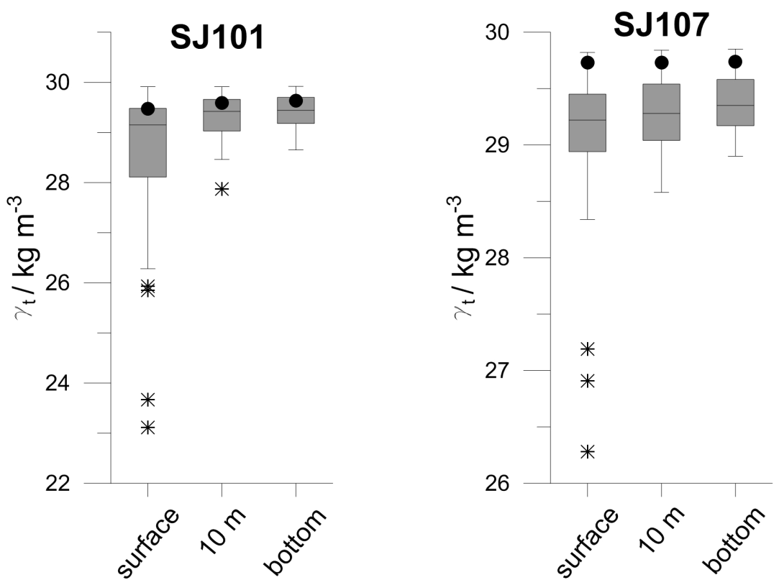
February 2017
Density: above the average, especially in the eastern part
February sigma-t values at SJ101 (west) and SJ107 (east) over the period 1969-2016 (Box-Whisker) and 2017 values (black dot).

Slide 19
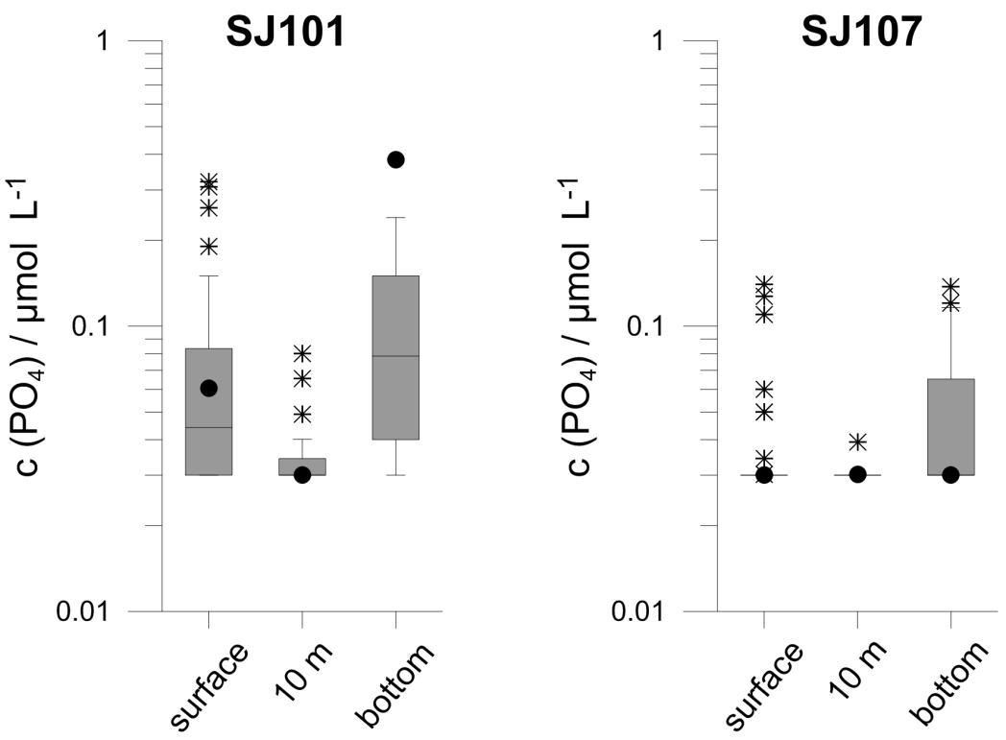
February 2017
Nutrients: generally around or above the average in the western and below the average in the eastern part
February PO₄ values at SJ101 (west) and SJ107 (east) over the period 1972-2016 (Box-Whisker) and 2017 values (black dot).

Slide 20
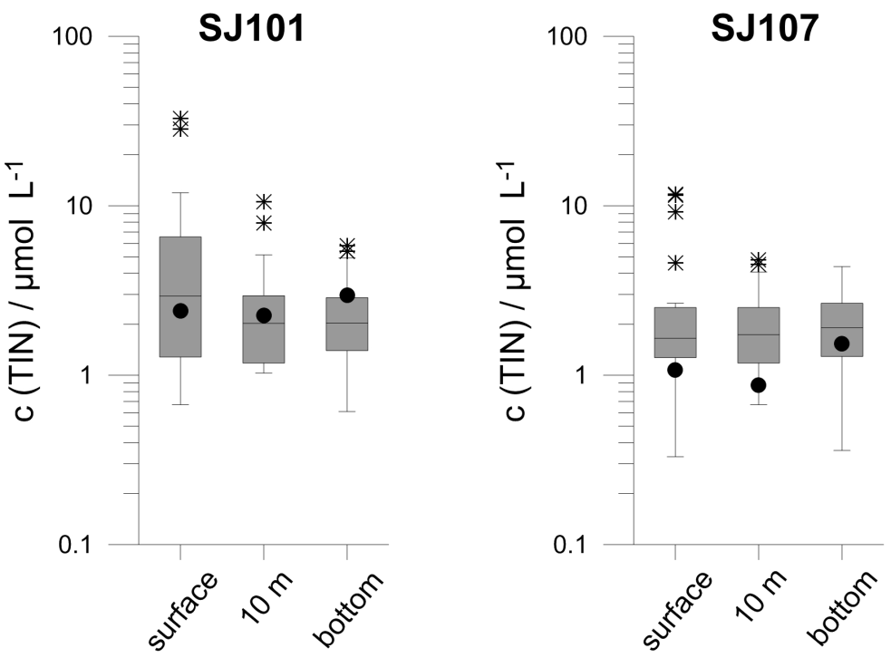
February 2017
Nutrients: generally around or above the average in the western and below the average in the eastern part
February TIN values at SJ101 (west) and SJ107 (east) over the period 1972-2016 (Box-Whisker) and 2017 values (black dot).

Slide 21
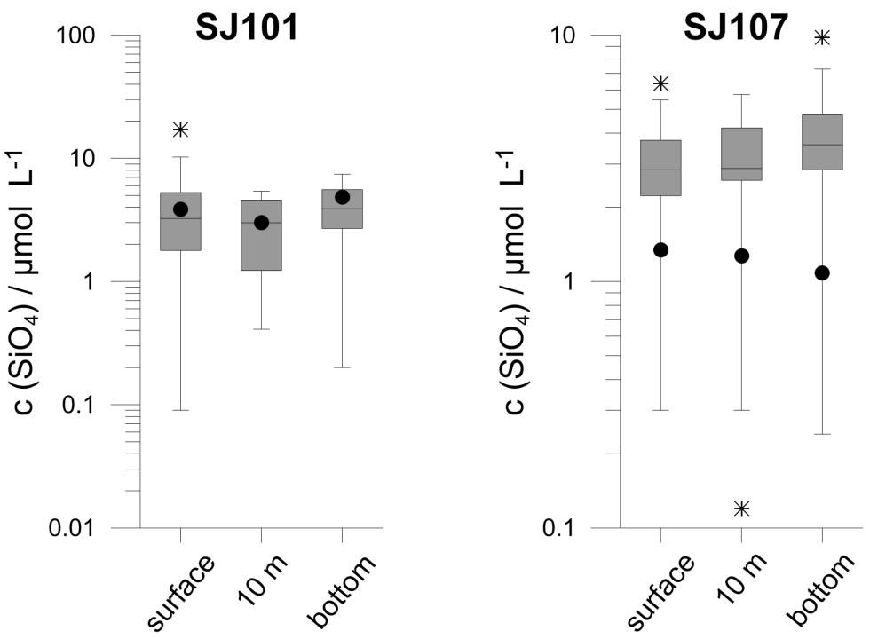
February 2017
Nutrients: generally around or above the average in the western and below the average in the eastern part
February SiO₄ values at SJ101 (west) and SJ107 (east) over the period 1972-2016 (Box-Whisker) and 2017 values (black dot).

Slide 22
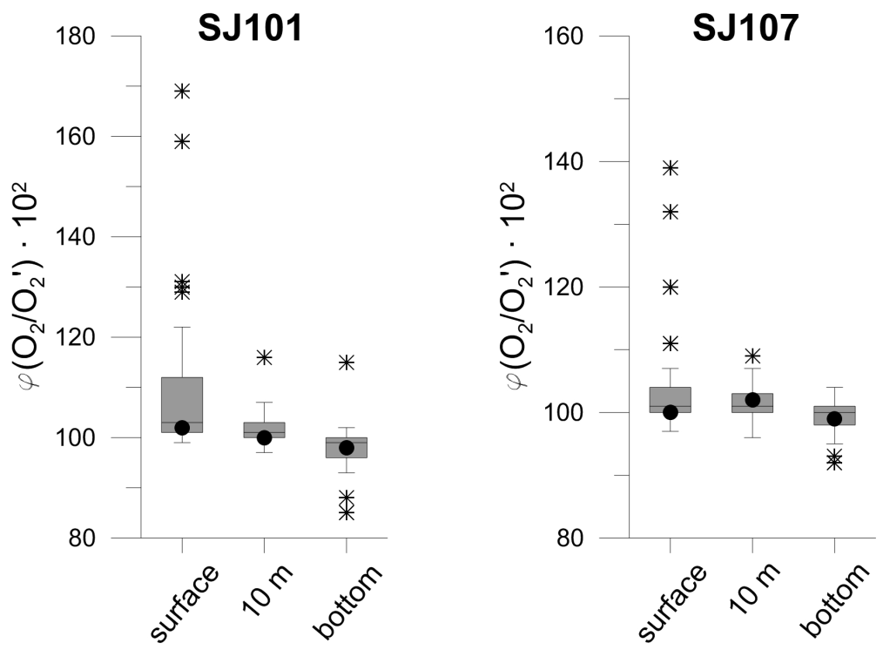
February 2017
Oxygen saturation: around the average
February oxygen saturation values at SJ101 (west) and SJ107 (east) over the period 1972-2016 (Box-Whisker) and 2017 values (black dot).

Slide 23
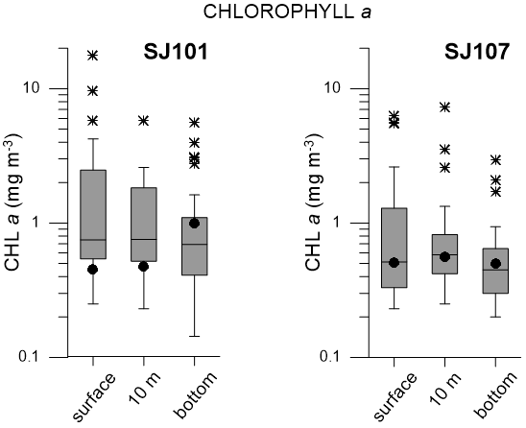
February 2017
Chlorophyll-a: below the average in the upper layers of SJ101 but above or around the average elsewhere
February chlorophyll-a values at SJ101 (west) and SJ107 (east) over the period 1972-2016 (Box-Whisker) and 2017 values (black dot).

Slide 24
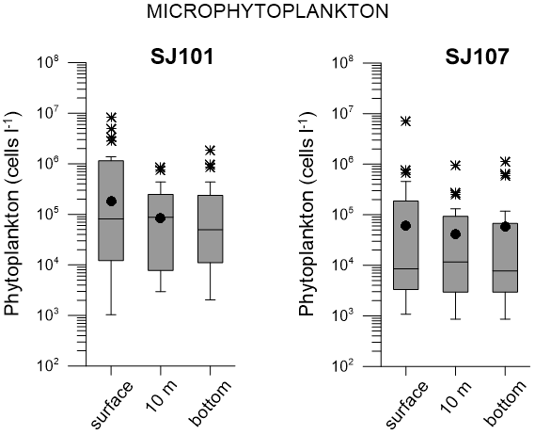
February 2017
Phytoplankton abundance: above the average
February microphytoplankton values at SJ101 (west) and SJ107 (east) over the period 1973-2009 (Box-Whisker) and 2017 values (black dot).

Slide 25
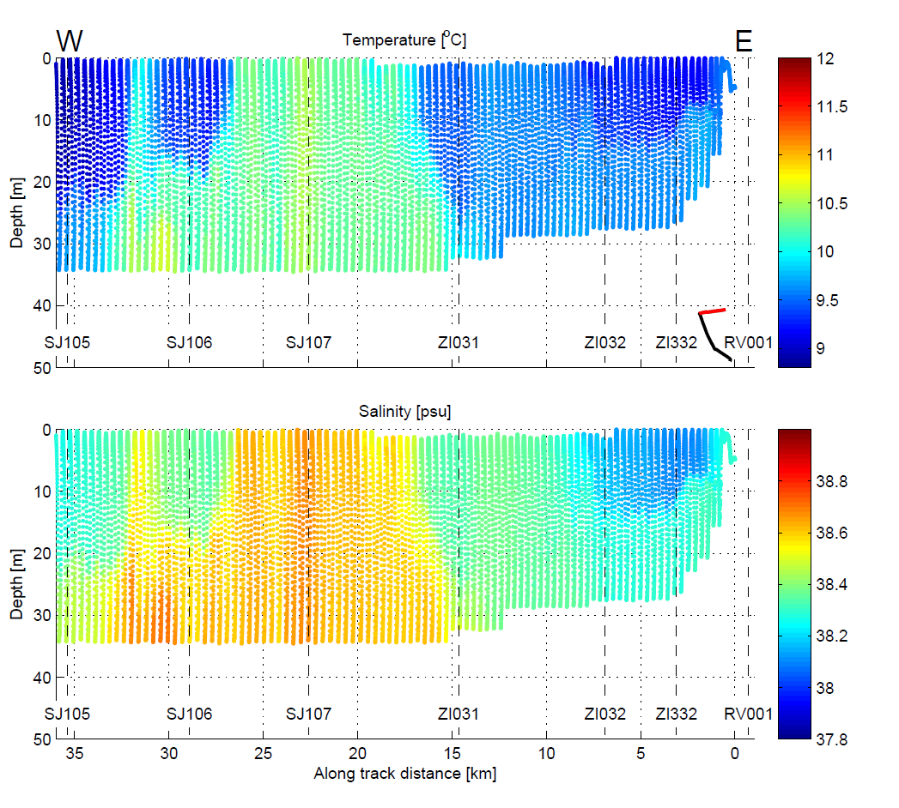
Phytoplankton abundance was especially high in the coastal zone of lower salinity near st. SJ107 (ZI032)

Slide 26
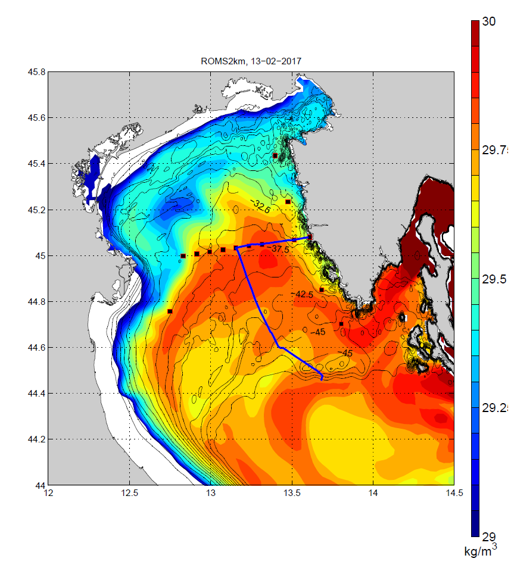
Phytoplankton abundance was especially high in the coastal zone of lower salinity near st. SJ107 (ZI032)

Slide 27
February 2017
Heterotrophic bacteria, cyanobacteria and heterotrophic nanoflagellates: no data for winter 2017 (but average long-term values for winter period were computed)

Slide 28
February 2017
particulate organic carbon (POC): values were higher in Feb 2017 than usual at SJ101 (0.4 mg/L), average for winter at SJ101 from 2008-2017 is around 0.1 mg/L

Slide 29
Results
our data indicate that in the winter of 2017 bioproduction was higher than average
however, salinity was high as well
how is it possible that large bioproduction occurs at high salinity?

Slide 30
Hypothesis
we hypothesize that nutrient rich Po waters were present in the large part of NA (especially in western), inducing high bioproduction, despite high salinity values – namely, salinity would be much higher without fresh water influence

Slide 31

February 2017
salinity values at SJ107 were among the highest values observed in NA while values at SJ101 are somewhat lower and are possibly a mix of very high salinity water and freshened waters from Po; possibly even waters at SJ107 were a mix of much saltier and freshened waters
February salinity values at SJ101 (west) and SJ107 (east) over the period 1969-2016 (Box-Whisker) and 2017 values (black dot).

Slide 32
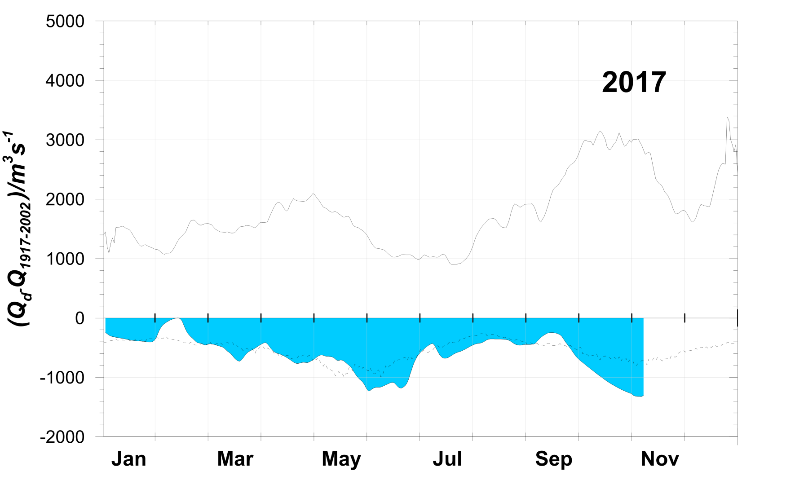
Po rates in the winter of 2017 were below the average...
Difference between the daily and long term averaged Po River discharge rates with mean positive and negative deviations.

Slide 33
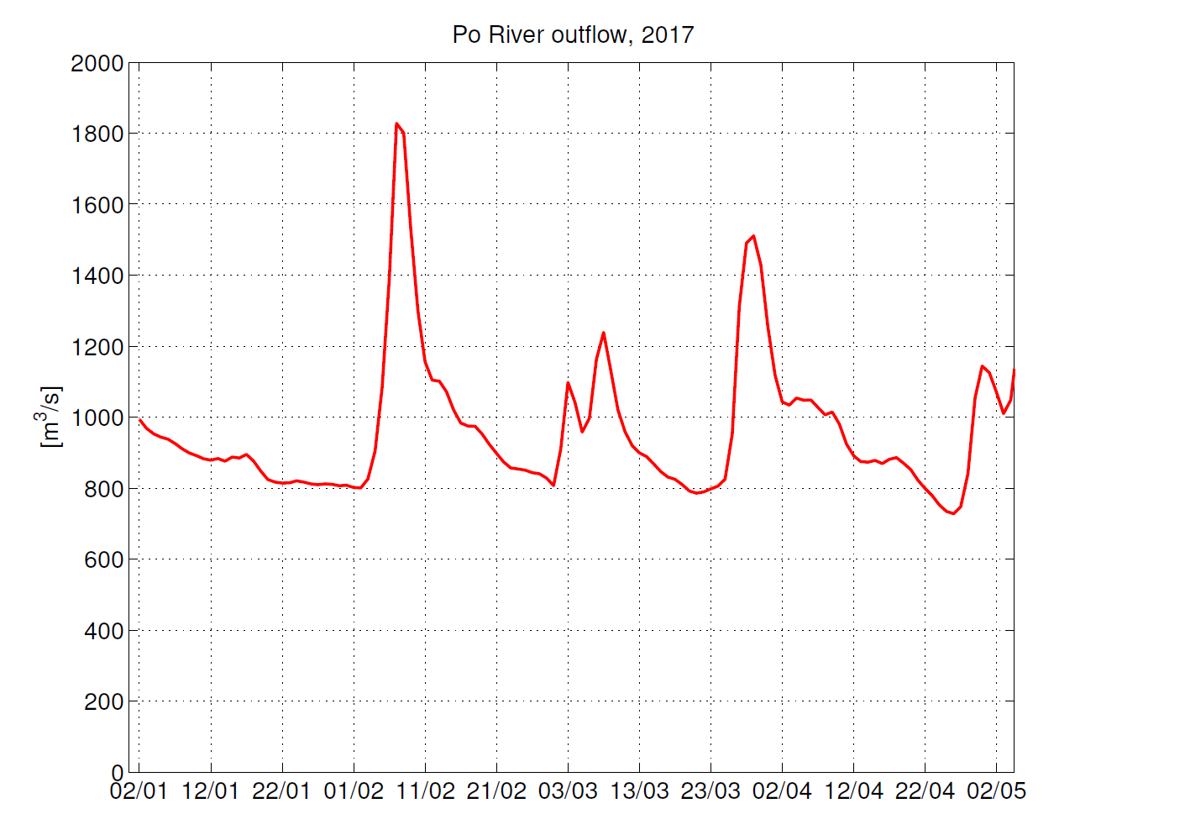
...with a small peak value on 6-9 February
Daily Po River discharge rates in winter 2017.

Slide 34
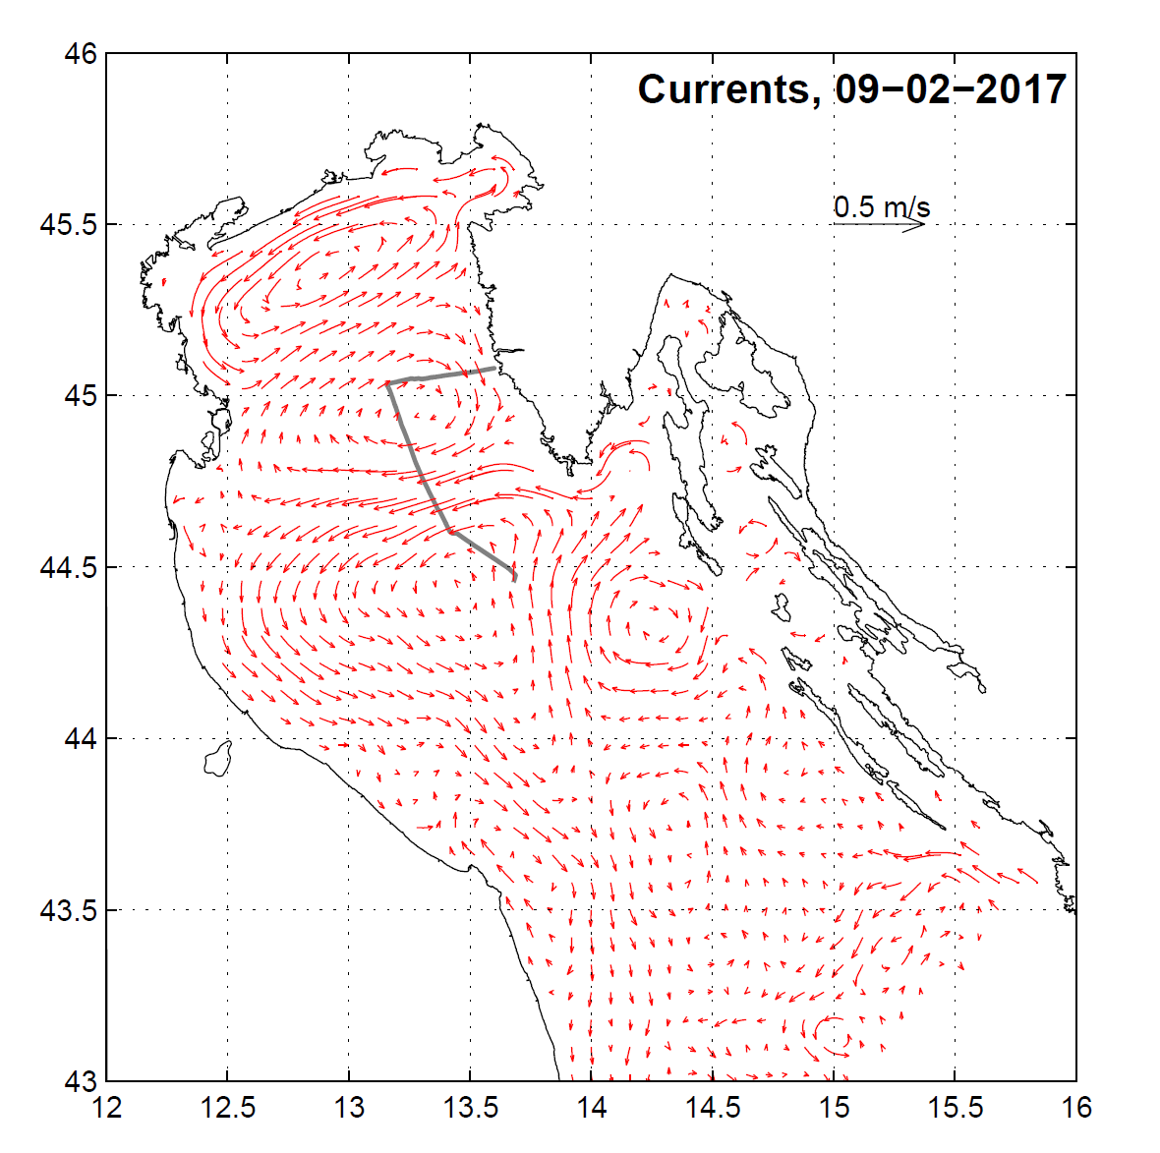
Current field (vert. averaged)
on 9 February, after a small peak in Po discharge, intense currents from the Po delta area toward east were observed

Slide 35
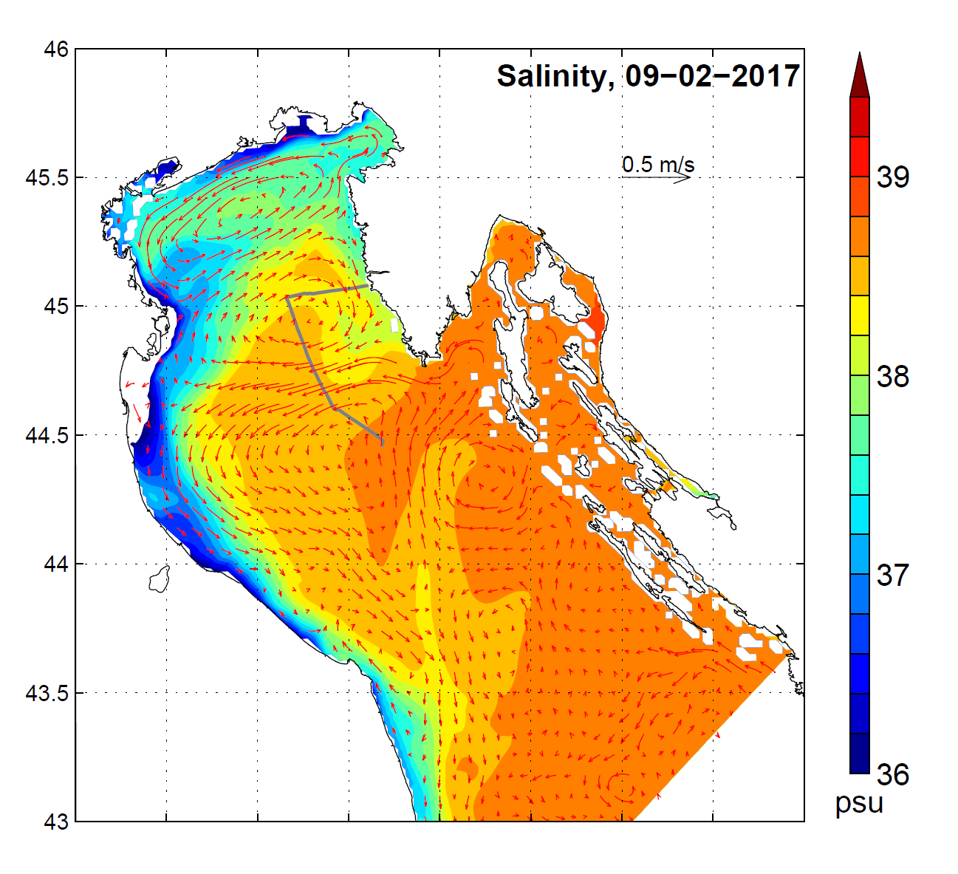
Current field and salinity (vert. averaged)
on 9 February, after a small peak in the Po River discharge, intense currents from the Po delta area toward east were observed

Slide 36
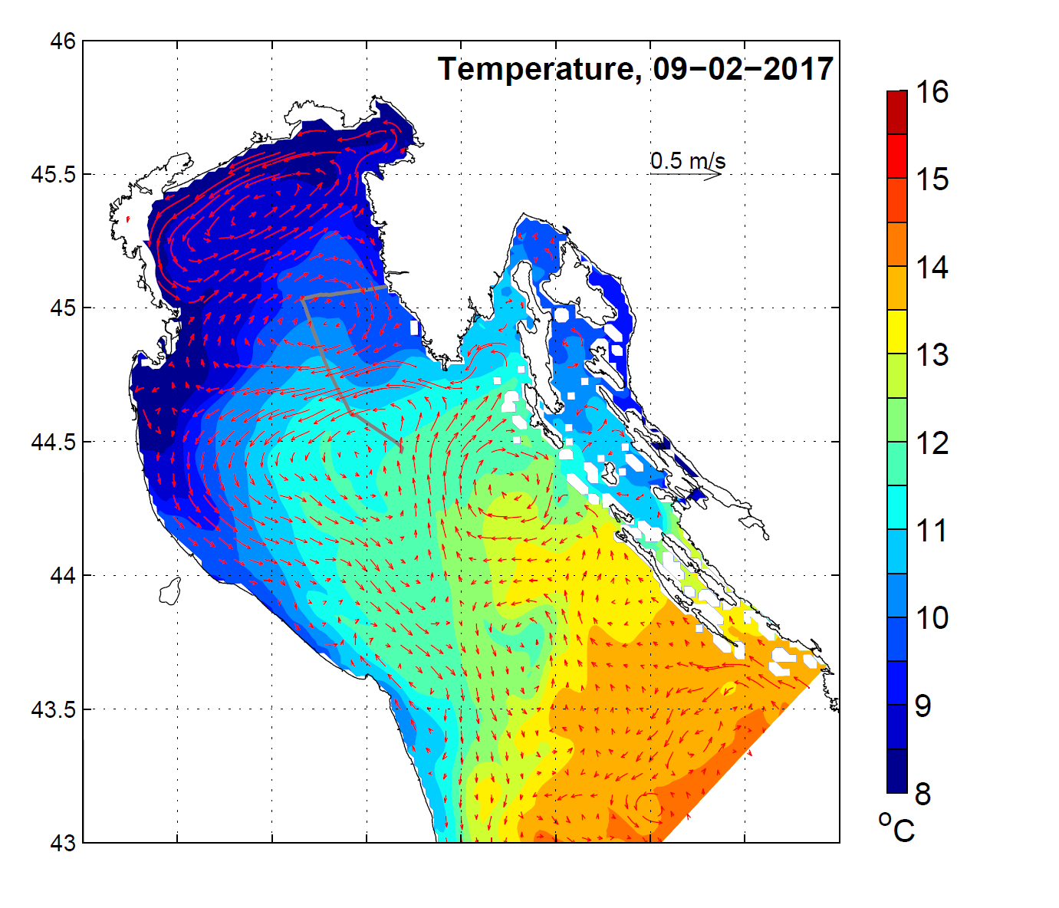
Current field and temperature (vert. averaged)
on 9 February, after a maximal winter Po discharge, intense currents from the Po delta area toward east were observed

Slide 37
Hypothesis
therefore currents distribution on 9 February supports the idea that freshened waters from the Po River were drawn into the NA inducing high bio-production

Slide 38
February 2017
dissolved organic carbon (DOC): values were below (1,020 mg/L at both SJ101 and SJ107) the winter average values (SJ101=1,201 mg/L; SJ107=1,105 mg/L )
high bioproduction together with a low amount of DOC suggest that bio-material is freshly formed (e. g. after episode of Po spreading across the NA on 9 February)

Slide 39
March 2017
in the next month, in March, zooplankton abundance was relatively high (there is a delay between phyto- and zoo-production) indicating additionally that 2017 was a winter in wich higher bioproduction occurred; due to the grazing activity DOC is increasing as well especially at SJ101

Slide 40
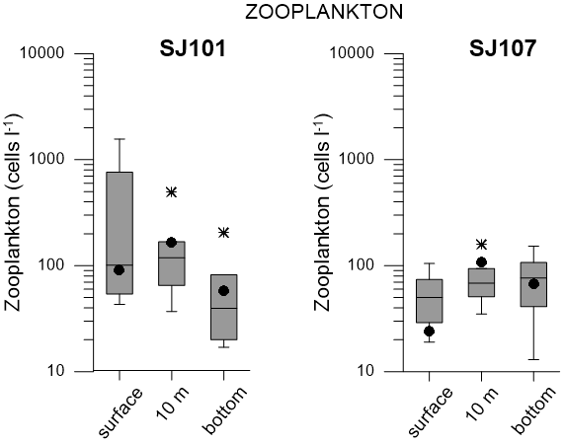
March 2017
Microzooplankton abundance: high or average in water column but below average at surface layer at SJ107)
March microzooplankton values (Ind. L⁻¹) at SJ101 (west) and SJ107 (east) over the period 2003-2008 (Box-Whisker) and 2017 values (black dot).

Slide 41
The winter of 2017
in the winter of 2017 high salinity and very dense water (around 29.7 kg m⁻³) was observed in the NA
in spite of high salinity the winter of 2017 seems to be of the A type with Po waters spreading across the NA and inducing high bioproduction
the NA waters of the winter of 2017, as very dense, were likely to flow out of the region

Slide 42
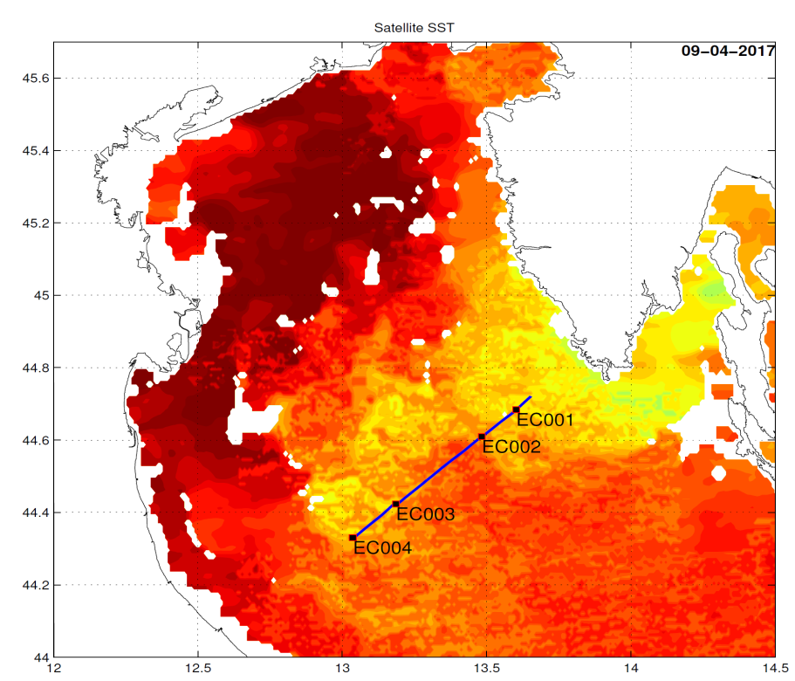
April 2017
in April we performed a cruise in the open sea to trace a path of dense water formed in winter and flowing out of the NA
as mentioned, this water can play an important role in the deep Adriatic or Mediterranean pits

Slide 43
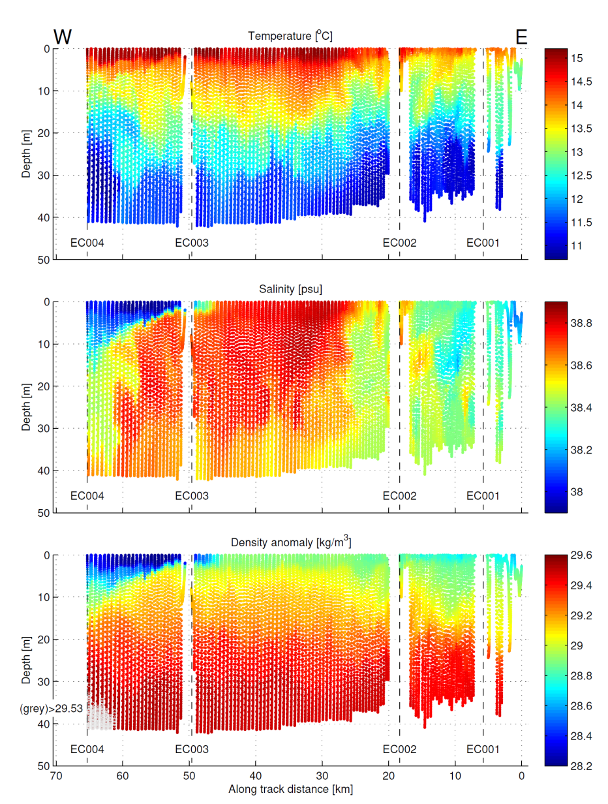
April 2017
very dense water was observed at bottom in central and western NA; with highest values close to the Po River delta, over 29.5 kg m ⁻³ at EC003 (29.47 kg m ⁻³ at EC002 and 29.39 kg m ⁻³ at EC001)

Slide 44
April 2017
dense water (29.52) and high salinity (38.6) water at bottom of EC003 station closest to the Po delta evidence outfow of winter dense water from the NA, possibly from the eastern part (where the densiest and more saline water was found in February)

Slide 45
April 2017
dense water was characterised by high abundance and high diversity of phytoplankton and lower nutrient concentration; chlorophyll is above the February median value; heterotrophic bacteria were lower and cyanobacteria well above February averages at SJ101 and SJ107; heterotrophic nanoflagelates seem to be very abundant as well; dissolved organic carbon was similar (av. 1.053 mg/l) as in February at SJ101 and SJ107 (av. 1.012) while particulate organic carbon POC was somewhat lower (0.063 mg/l) in comparisson to 0.124 (av. for SJ101 i SJ107)

Slide 46
Conclusion I
we observed relatively high bio-production in the winter season of 2017 due to spreading of freshened riverine Po waters towards east in conditions of very high density and salinity;
it seems that the winter of 2017 was of A type

Slide 47
Hypothesized circulation patterns in winters of A and B type:
type A type B

Slide 48
Conclusion II
bottom dense water flowing out of the NA was lower in nutrient concentration but high in (micro) bioproduction

Slide 49
Future work
we will try to model the situation we described and analysed here

Slide 50

Acknowledgement
This work has been supported in part by Croatian Science Foundation under the projects EcoRENA (Ecological response of northern Adriatic to climatic changes and anthropogenic impact), SPHERE (The Sulphur and Carbon Dynamics in the Sea- and Fresh-Water Environment) and ADAM-ADRIA (Advanced Data Assimilation Methods and Measurements in the Adriatic Sea; HRZZ-IP-2013-5928)

